Slide 2




Who are we
Aaditya Purani (aka knapstack)
Senior Security Engineer @ REDACTED
AppSec and Blockchain
CTFs with perfect blue
@aaditya_purani
Max Garrett. (aka thegrandpew)
Application Security Auditor @ Cure53
AppSec and Blockchain
CTFs with Water Paddler
@thegrandpew

Slide 3






What is Electron?
Popular Cross-Platform Desktop Application Framework
Chromium + Node JS = Electron
Used by VSCode, Teams, Discord, Slack and 500+ more Applications
…

Slide 4
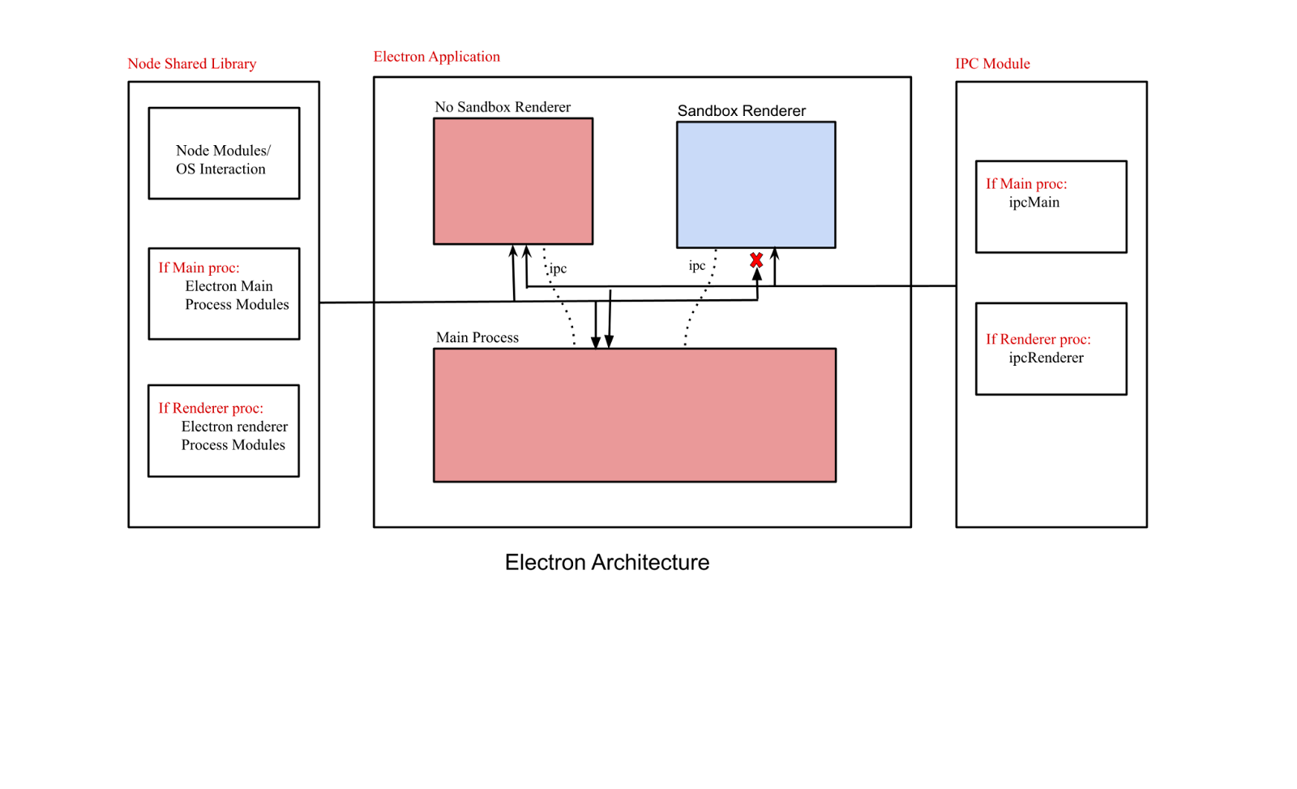
Main Process: Menu, Tray, Node, ipcMain, creates Renderer Process using BrowserWindow
Renderer Process: DOM API, Node.js API, ipcRenderer

Slide 5
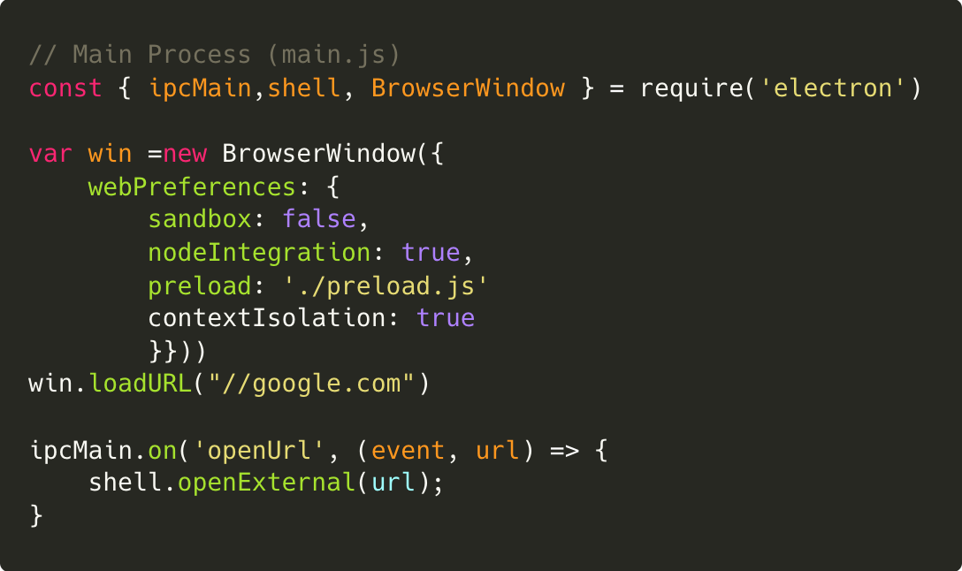
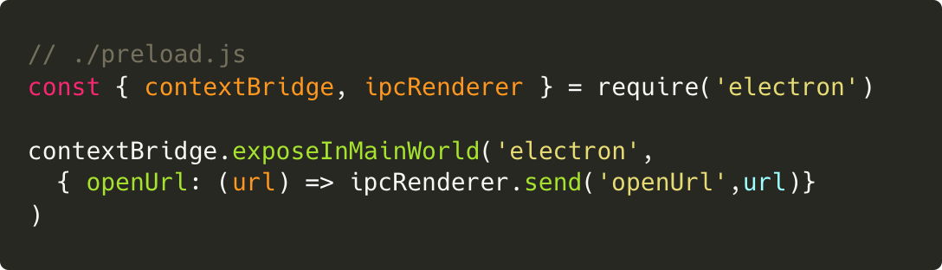
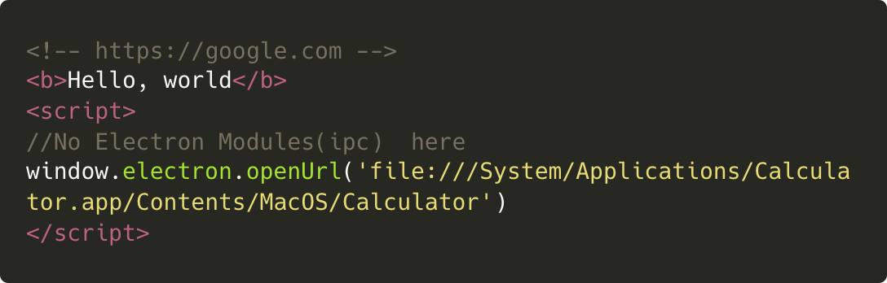
Main Process
Renderer Process

Slide 6
Sandboxed Renderer:
(new BrowserWindow({ webPreferences: { sandbox: true, nodeIntegration: true } })).loadURL(‘//example.com’)
Non-Sandboxed Renderer:
(new BrowserWindow({webPreferences:{ sandbox: false, nodeIntegration: true } })).loadURL(‘//example.com’)

Slide 7
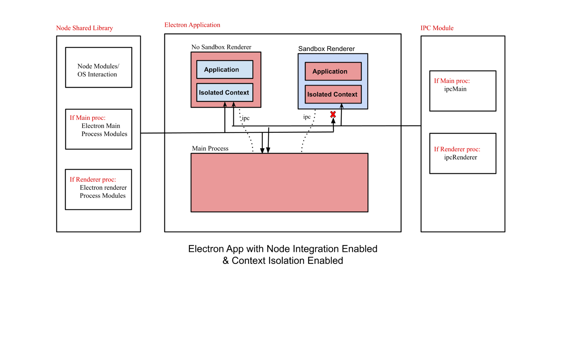

Slide 8
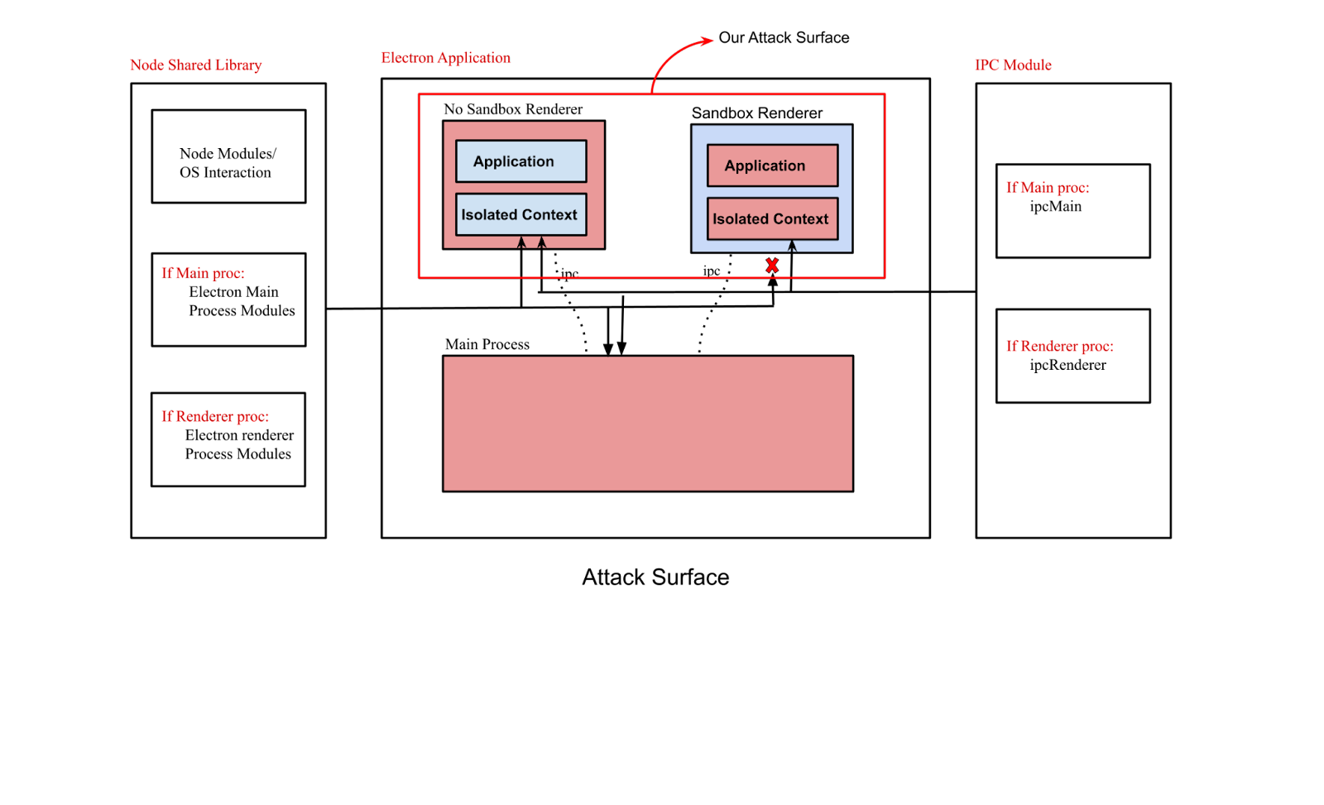

Slide 9
Terminologies
Node Integration => NI
Context Isolation => CI
Node Integration in Workers => NIW
Node Integration in Subframes => NISF (Exposes preload)
Sandbox => SBX

Slide 10
NI: true, CISO: false, SBX: false
Easy to get a shell as node is exposed to the renderer
Find a way to embed your JavaScript
Non-Sandboxed Renderer:
(new BrowserWindow({webPreferences:{ sandbox: 0, nodeIntegration: 1, contextIsolation: 0 } })).loadURL(‘//example.com’)

Slide 11


Slide 12
Case Study 1: VS Code RCE bypassing Restricted Mode (CVE-2021-43908)
Bypasses “Trust Codebase” checkbox, allowing RCE to work even if you open untrusted codebases.
Limited markdown XSS -> RCE chain
Advisory: https://msrc.microsoft.com/update-guide/vulnerability/CVE-2021-43908

Slide 13
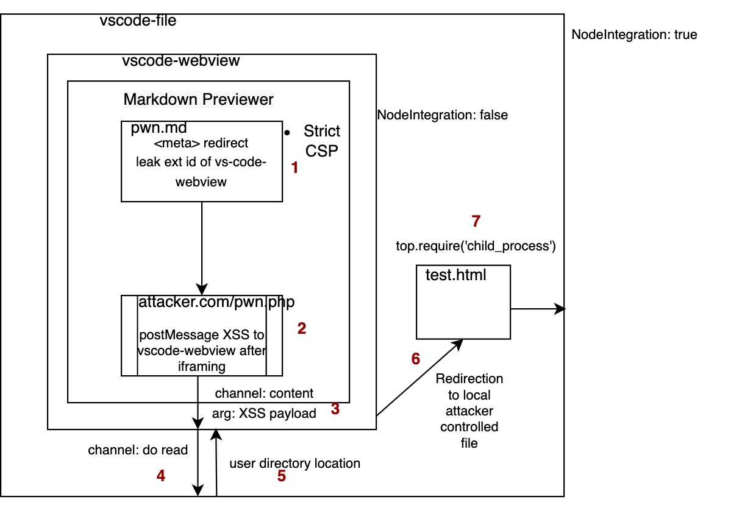
Case Study 1: VS Code RCE Flow

Slide 14
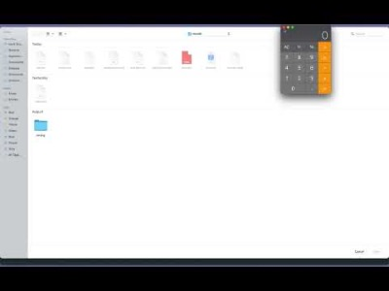
Demo 1

Slide 15

I want

Slide 16
NI: false/true, CISO: false, SBX: false
If CISO is enabled, node is not directly available in renderer.
Electron creates isolated context so that Electron’s internal logic and preload scripts run in separate context
Node can only be accessed in isolated context via preload.js.
Two ways to exploit 💡
- Can use Render Exploit because no sandbox
- Can disable Context Isolation more about this in coming slides

Slide 17

Node/Electron APIs here
XSS/Embed here
Disabled

Slide 18

Case Study 2: Discord RCE
Was using Electron/12.14.1, Chrome/83.0.4103.122
2. XSS in one of the video embeds but Iframes are sandboxed in electron.
3. Used Electron new-window handler mis-config in Discord to open https://example.com/exp.html in new Electron Window which has no-sandbox enabled
4. Run v8 renderer exploit (CVE-2021-21220) to get RCE

Slide 19
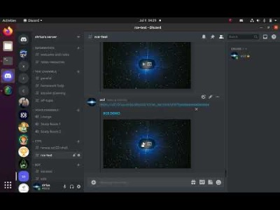
Demo 2

Slide 20

Woo, That’s fun. I want even more

Slide 21
NI: false, CISO: false, SBX: true/false
Sandbox is enabled on renderers(seccomp, win32k lockdown)
No node modules exposed in renderer
No Isolation between website you load in webContents and preload/Electron internal code

Slide 22
Electron App with Node Integration disabled
& Context Isolation disabled

Slide 23
How to get shell?
Electron <10
Use prototype pollution gadget to leak remote/IPC module.
Use Remote Module which gives node access.
Electron 10<version<14
Use prototype pollution gadget to leak remote/IPC module.
If Remote Module Explicitly Enabled
IPC Misconfiguration
Note: Remote Module bridges JavaScript objects from the main process to the renderer process using IPC.

Slide 24
How to get shell?
Electron >14
Use prototype pollution gadget to leak IPC module.
Remote is deprecated
Only IPC Misconfigurations on the main process

Slide 25
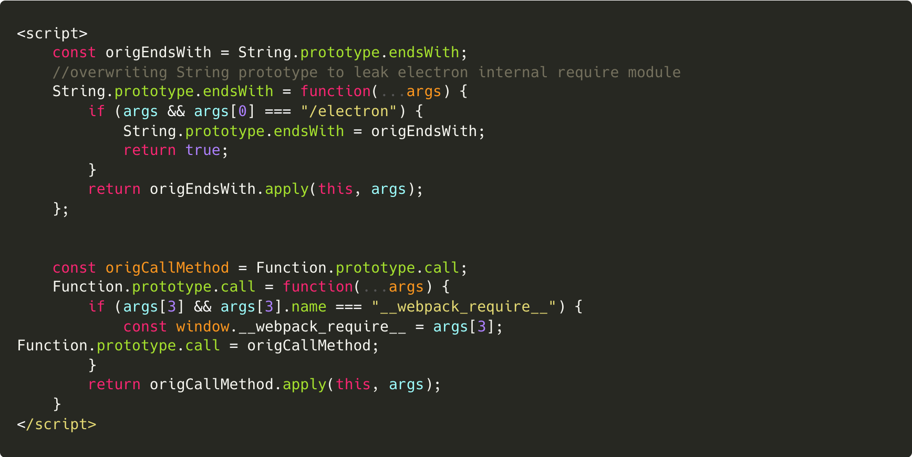
Prototype Pollution
Prototype Pollution
1
2
3

Slide 26
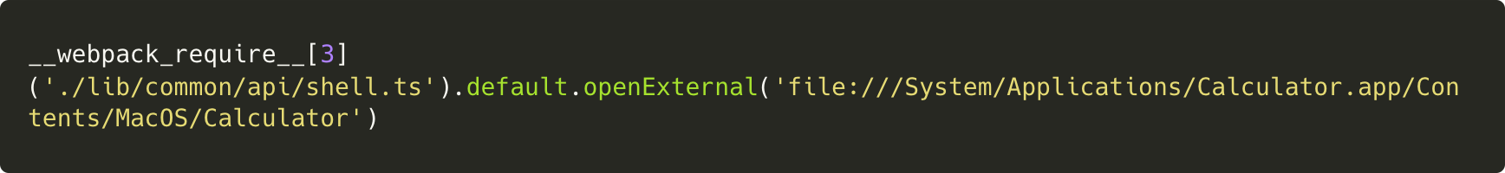
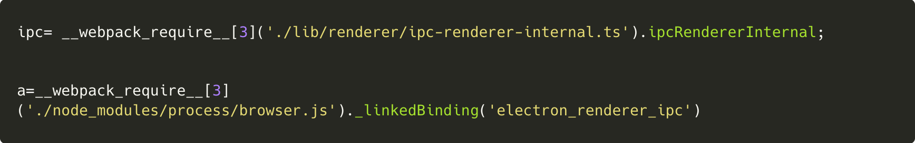
Prototype Pollution
sandbox: false, nodeIntegration: false, contextIsolation: false
sandbox: true, nodeIntegration: false, contextIsolation: false
⚠️ Leaks IPC Renderer Internal (i.e., ELECTRON_*, GUEST_*, etc. channels) and IPC Renderer (developer defined channels)

Slide 27

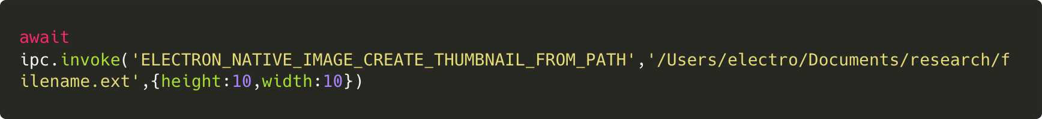
CVE-2021-39184
Sandboxed renderers can obtain thumbnails of arbitrary files through the nativeImage API
Windows:
IThumbnailCache::GetThumbnail
OSX:
QLThumbnailCopyImage
Ref: https://github.com/electron/electron/security/advisories/GHSA-mpjm-v997-c4h4 (Credits to nornagon)

Slide 28
Case Study 3: Local file read in MS Teams
1. Using Electron <15
2. XSS in Renderer using 0day in CKEditor (CVE-2021-44165)
3. CISO is disabled on new windows and Sandbox is Enabled.
4. Used prototype pollution gadget to leak IPC using XSS.
5. Send an IPC to browser process which reads given file in file path.

Slide 29
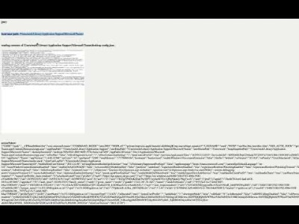
Demo 3

Slide 30

MOREEE

Slide 31
NI: false, CISO: false, SBX: true
Used by most of the applications
No node modules exposed in renderer
IPC cannot be leaked via prototype pollution as CI is enabled
Sandboxed

Slide 33
So, is it just like a XSS in browser?
> Nope!

Slide 34
Enabling Node Integration in SubFrames from compromised Renderer (CVE-2022-29247)

Slide 35
What is nodeIntegrationInSubFrames
nodeIntegrationInSubFrames – Experimental option for enabling Node.js support in sub-frames such as iframes and child windows if nodeIntegration enabled and sandbox disabled in the first place.
All your preloads will load for every iframe
Node is not available on sandboxed frames/windows, only APIs which uses IPC can be exposed using contextBridge

Slide 36
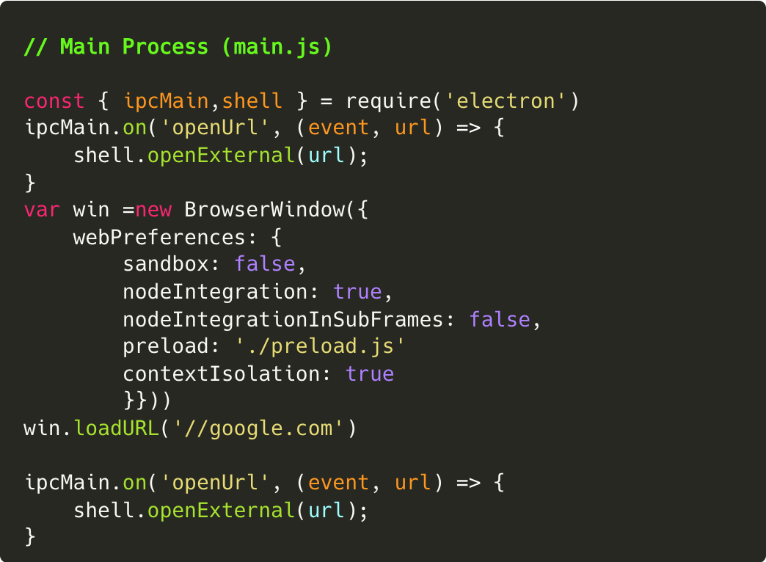
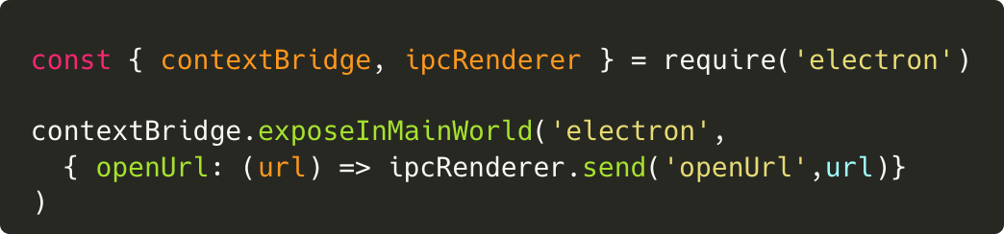
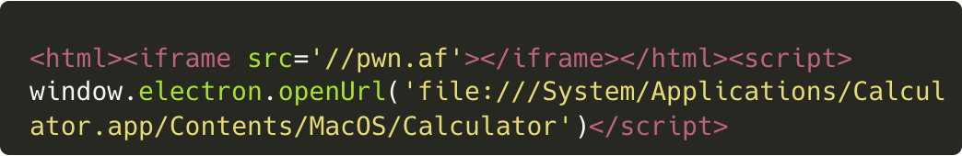
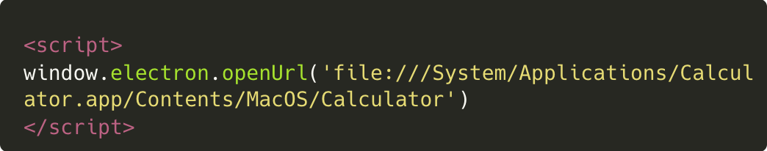
nodeIntegrationInSubFrames: false
Renderer Process
Main Process
preload.js (Isolated World/context)
Renderer Process (//google.com), Main window
Iframe in Main Window (//pwn.af) – Error Thrown

Slide 37

nodeIntegrationInSubFrames: true
Renderer Process
Main Process
preload.js (Isolated World/context)
Renderer Process (//google.com), Main window
Iframe in Main Window (//pwn.af) – No Error Thrown, Calc pops

Slide 38
nodeIntegrationInSubFrames: false
Most of the time we get XSS in the subframe or iframes
And nodeIntegrationInSubFrames is mostly disabled
No access to contextBridge exposed APIs

Slide 39
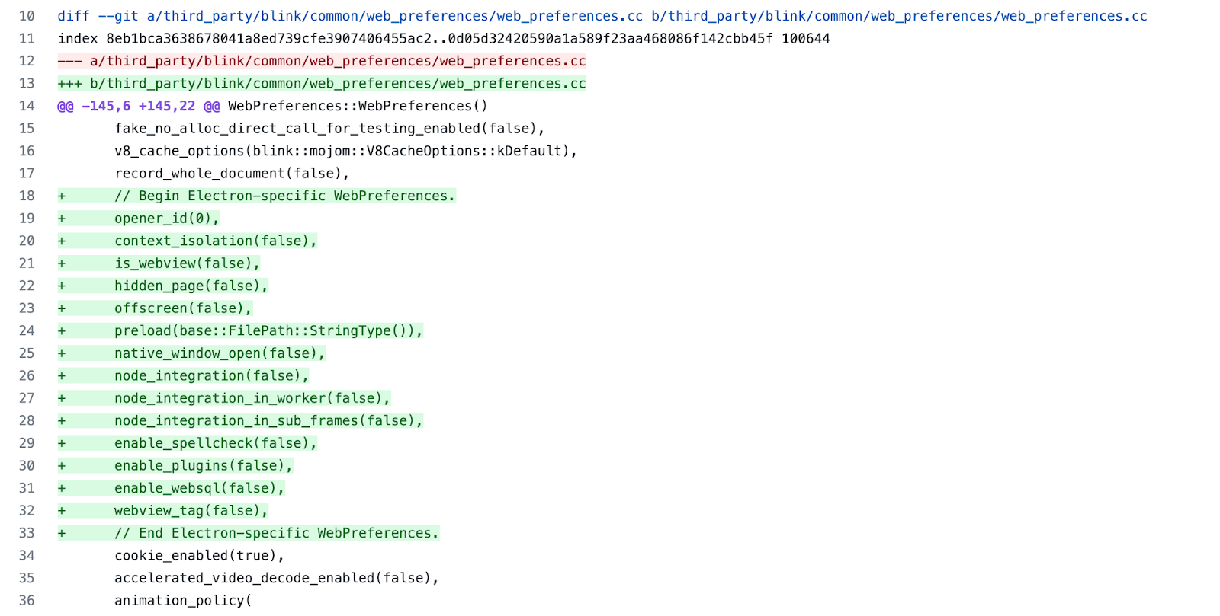
Implementation of Node Integration in SubFrames
Electron patches blink WebPreferences and adds settings like node_integration_sub_frames, context_isolation, etc.

Slide 40
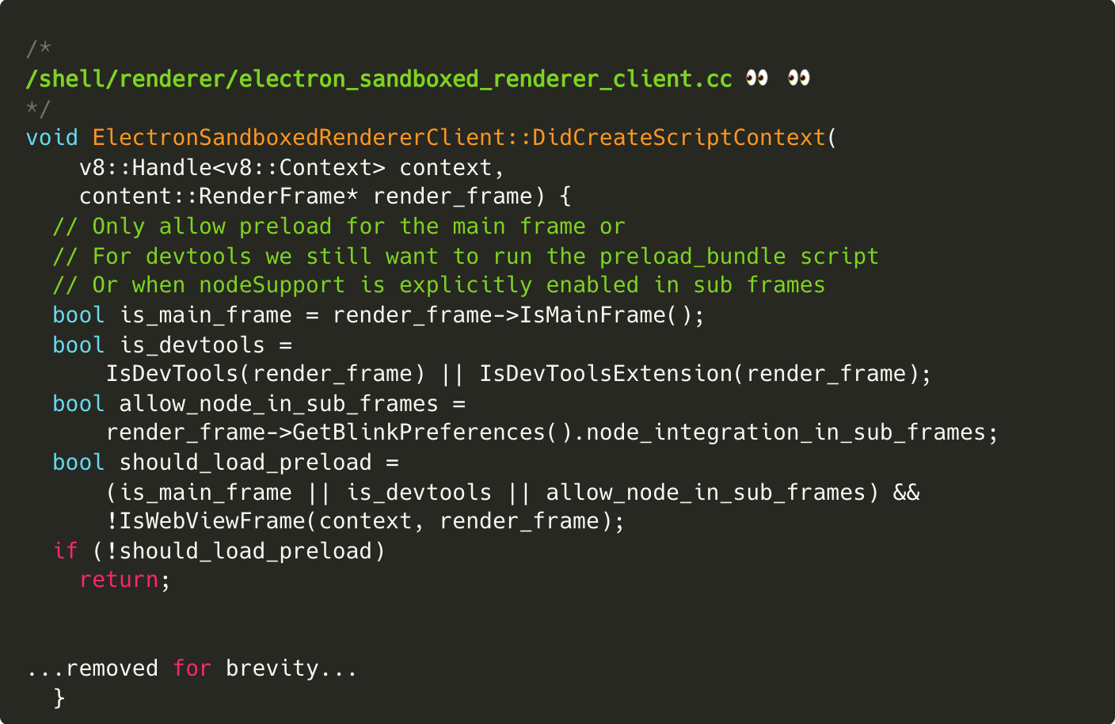
Implementation of Node Integration in SubFrames
If node_integration_in_sub_frames on WebPreferences is true, then expose preload contextBridge API
1

Slide 41
Enabling NISF using renderer exploit
An astute reader will notice that the check is on the renderer process.
Use renderer exploit and we can set node_integration_in_sub_frames to 1 😈
Reference: https://github.com/electron/electron/blob/bd10b19b0cdc46cdbadb570af89305e64541b679/shell/renderer/electron_sandboxed_renderer_client.cc#L217

Slide 42
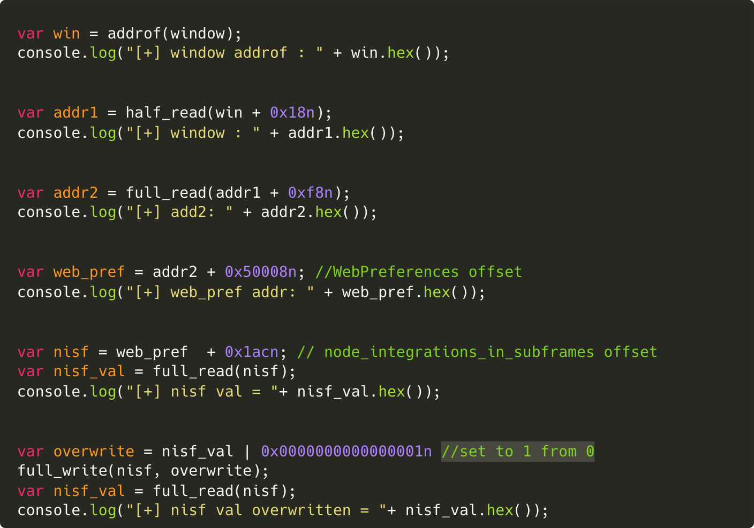
Enabling NISF using renderer exploit
1
2
3

Slide 43

Case Study 4: Element RCE (CVE-2022-23597)
Using Chrome/91.0.4472.164, Electron/13.5.1.
XSS on embed via deep link mis-config.
No contextBridge API on embed.
Run Renderer Exploit to expose contextBridge API on embed.

Slide 44
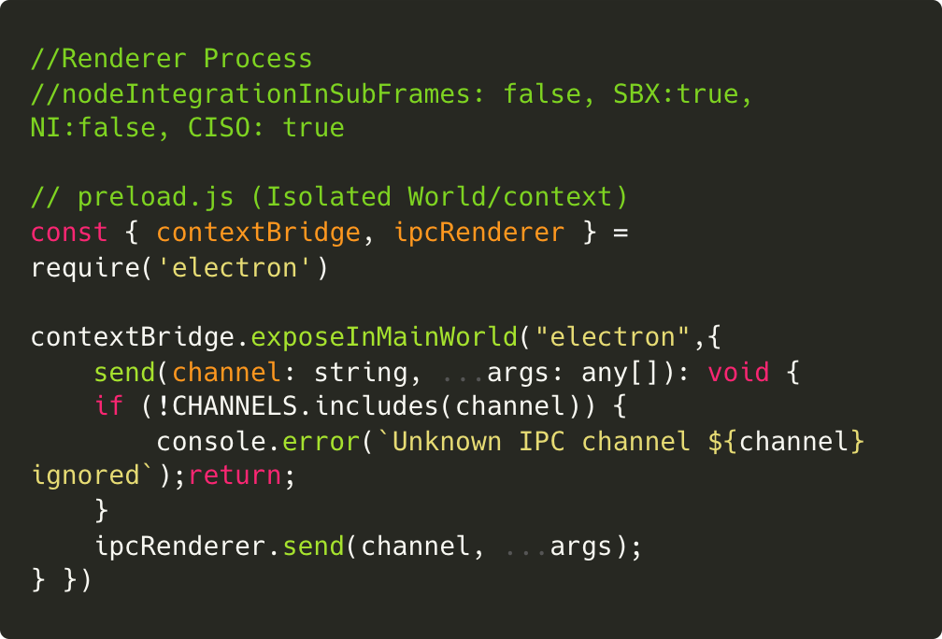
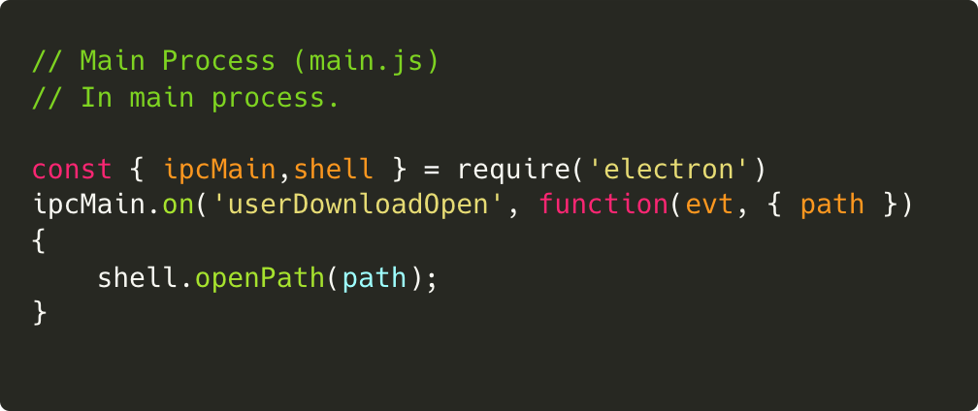
Case Study 4: Element RCE (CVE-2022-23597)

Slide 45
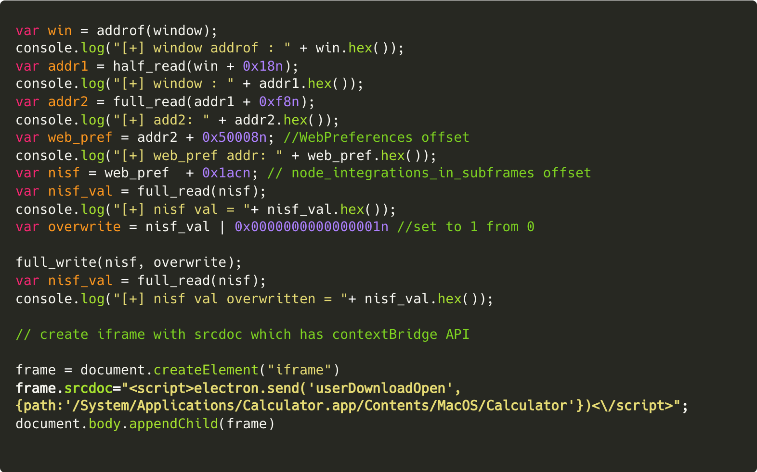

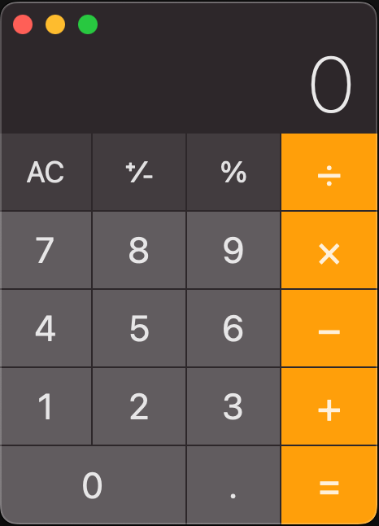
Case Study 4: Element RCE (CVE-2022-23597)
IFRAME

Slide 46
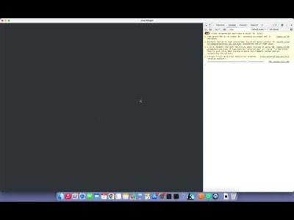
Demo 4

Slide 47


Slide 48
Disabling Context Isolation from compromised Renderer (CVE-2022-29247)

Slide 49
Implementation of Context Isolation
Electron patches blink WebPreferences and adds settings like node_integration_sub_frames, context_isolation, etc.

Slide 50
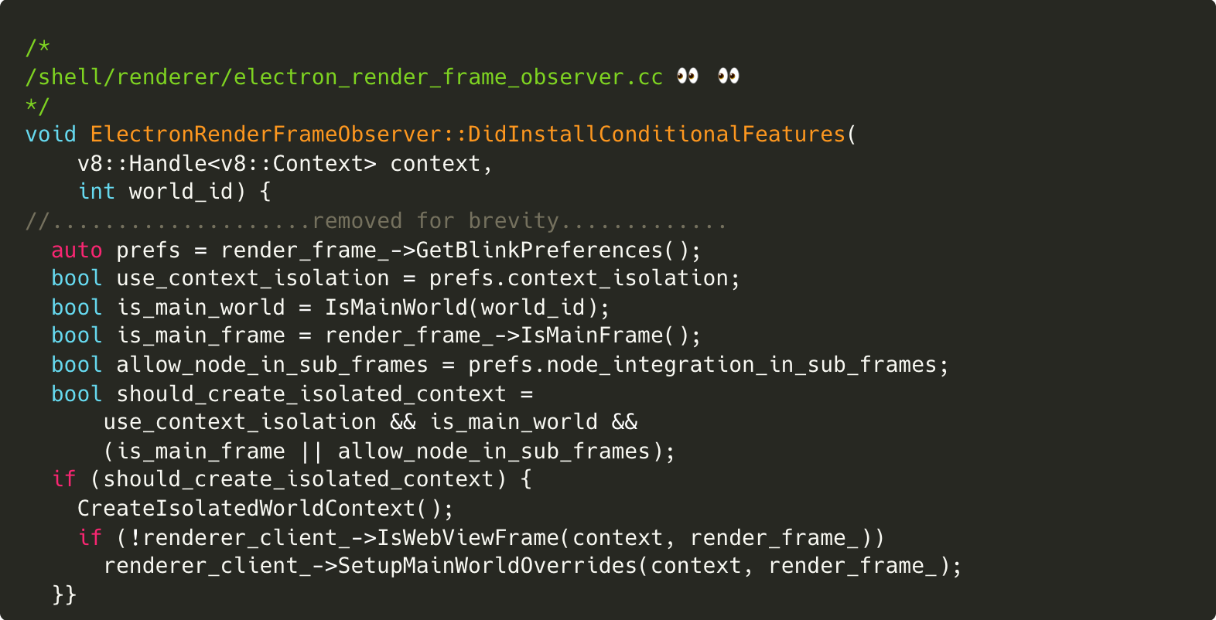
Implementation of Context Isolation
1
If context_isolation on WebPreferences is true, create isolated context
2
3

Slide 51
Disabling CISO using Renderer exploit
Same story using renderer exploit and we can set context_isolation to 0 😈
Reference: https://github.com/electron/electron/blob/35ac7fb8e61be744206918684a6881d460591620/shell/renderer/electron_render_frame_observer.cc#L133

Slide 52
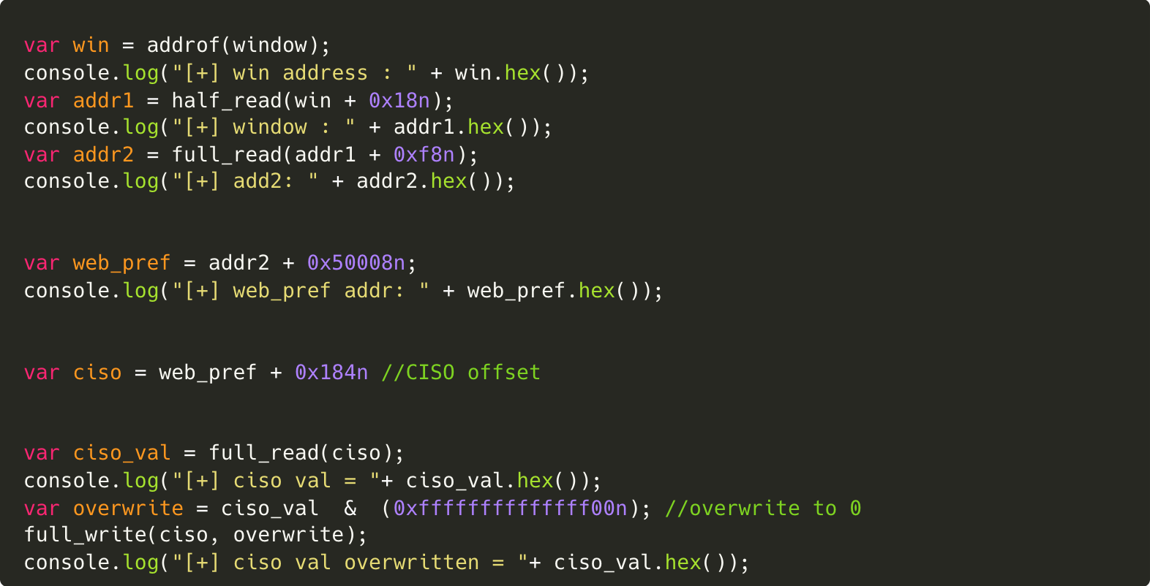
Disabling CISO using Renderer exploit
1
2

Slide 53
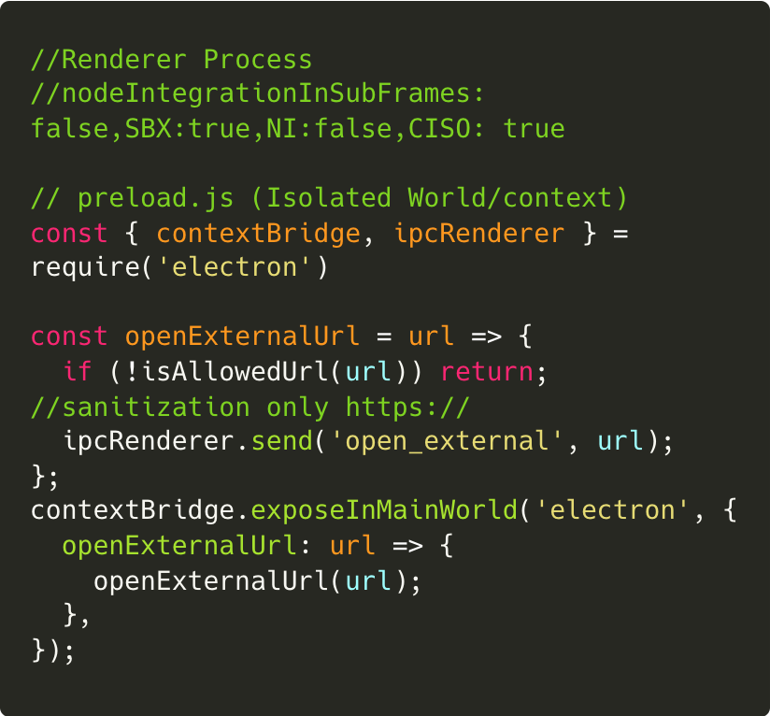
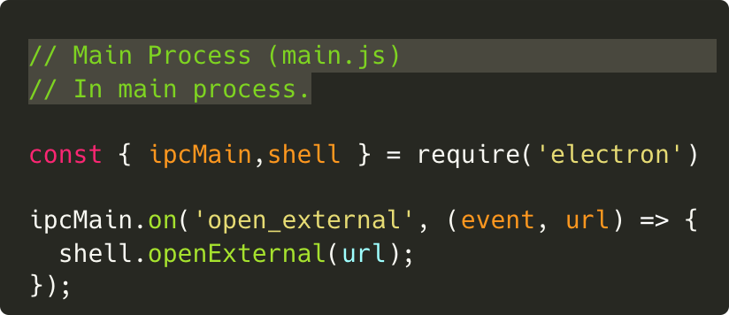
Case Study 5: RCE in Undisclosed app
Using Chrome/94.0.4606.71, Electron/15.1.2.
A “feature” to embed untrusted content in iframe

Slide 54
Case Study 5: RCE in Undisclosed app
Enabling NISF, doesn’t work because there is URL sanitization.
But we can disable context isolation and leak ipcRenderer and send ipcRenderer.send(‘open_external’, ‘file:///calc’)

Slide 55
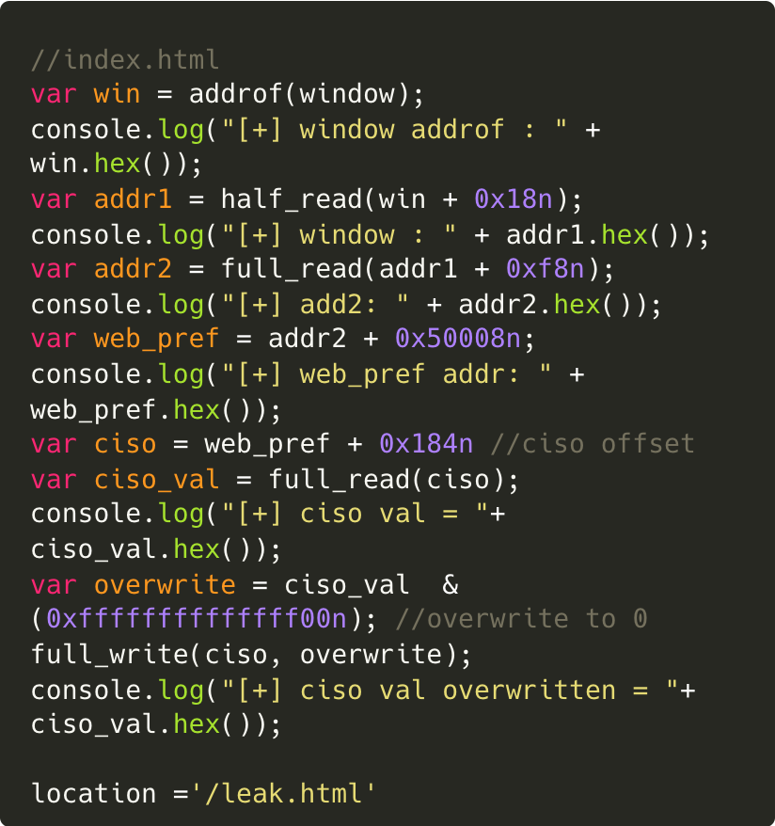
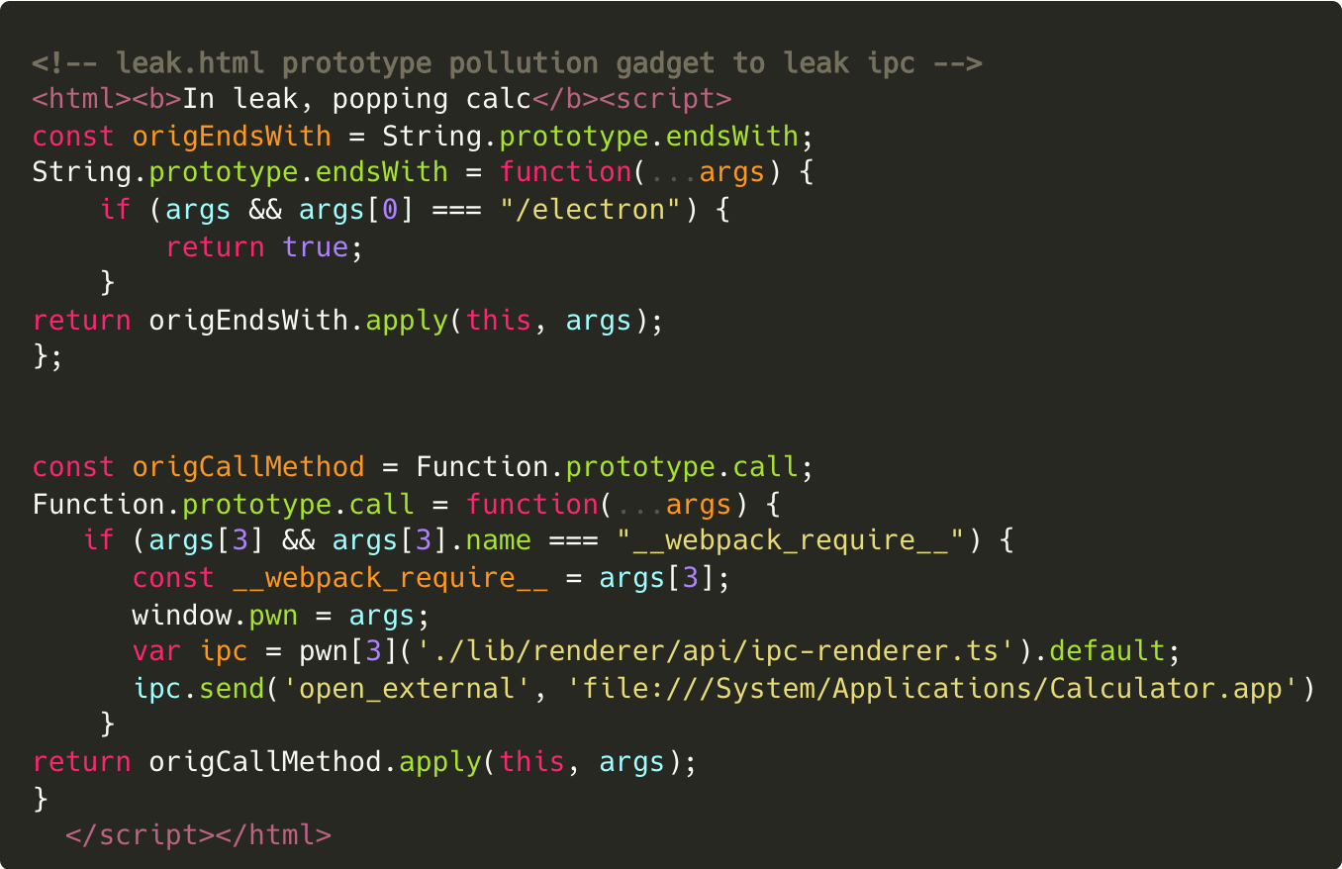
Case Study 5: RCE in Undisclosed app
index.html
leak.html
Prototype pollution to leak IPC

Slide 56

Demo 5

Slide 57
Disabling Context Isolation from compromised Renderer in older versions

Slide 58
Case Study 6: RCE in Undisclosed app
Using a pretty old version of Electron (11.4.5) with remote module enabled.
XSS in one of the embed.
Leverage it to disable Context Isolation
Leak Remote Module using Prototype Pollution Gadget
Get shell remote.process.binding(‘spawn_sync’)

Slide 59
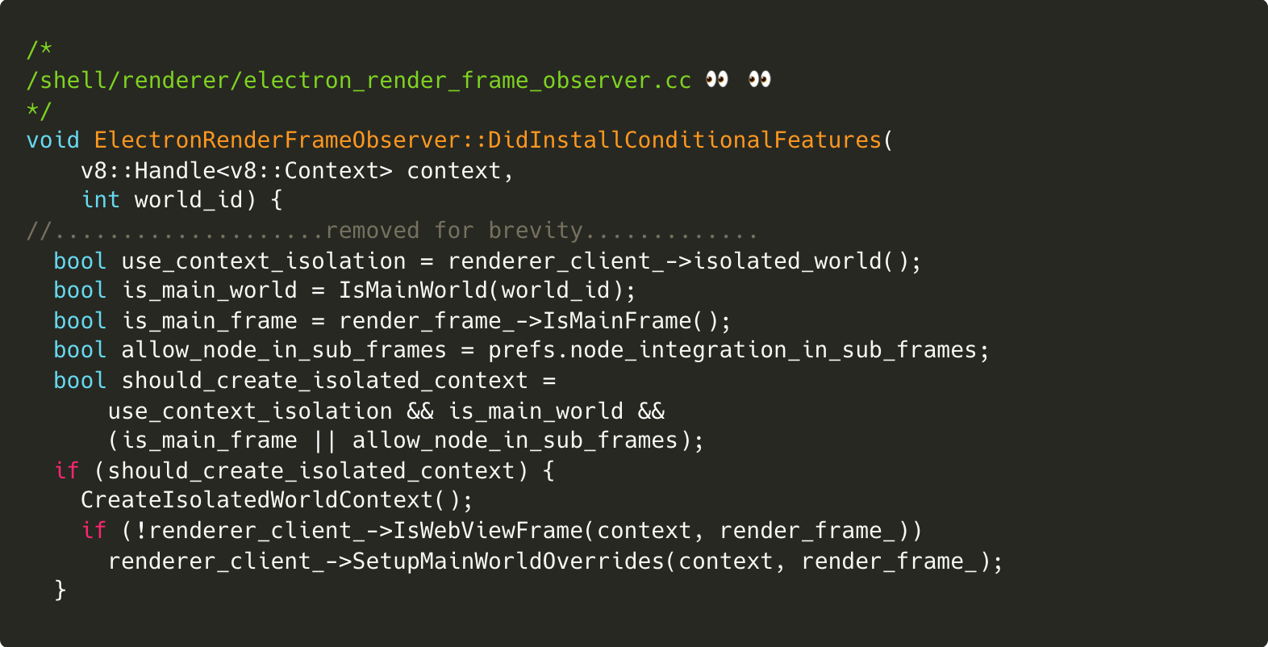
Disabling CISO on old electron version
In old electron, context_isolation is implemented differently.
Doesn’t use WebPreferences
Stores on renderer_client_
1
2

Slide 60
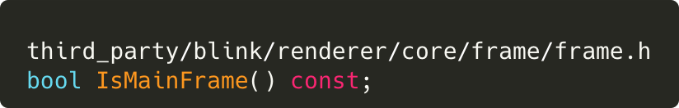
Disabling CISO on old electron version
Prototype Pollution Gadget only work if the current window is MainFrame (top window)
We can make ourselves top by overwriting IsMainFrame to 1 😈
Reference: https://source.chromium.org/chromium/chromium/src/+/main:third_party/blink/renderer/core/frame/frame.h;l=139?q=ismainframe&ss=chromium

Slide 61
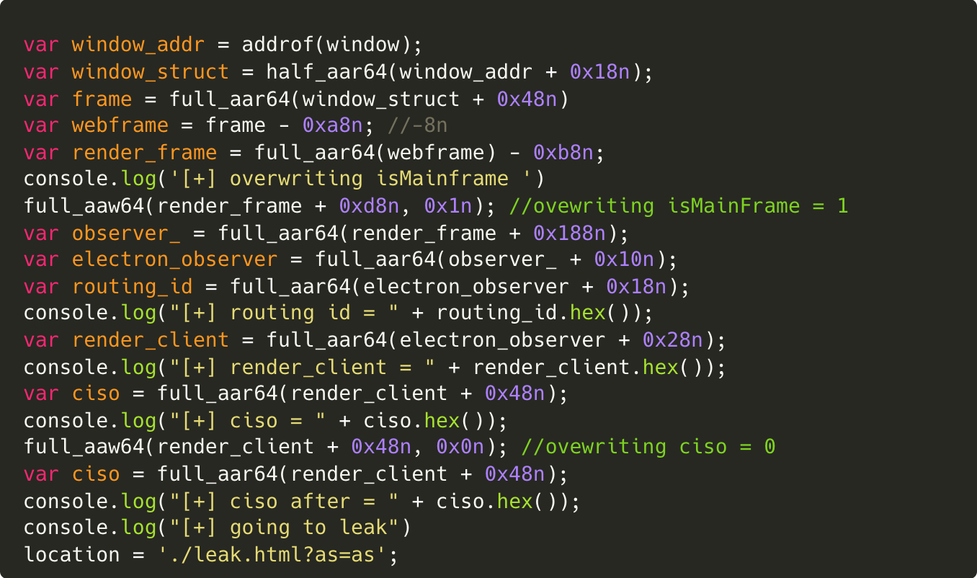
Disabling CISO on old electron version
1
2

Slide 62
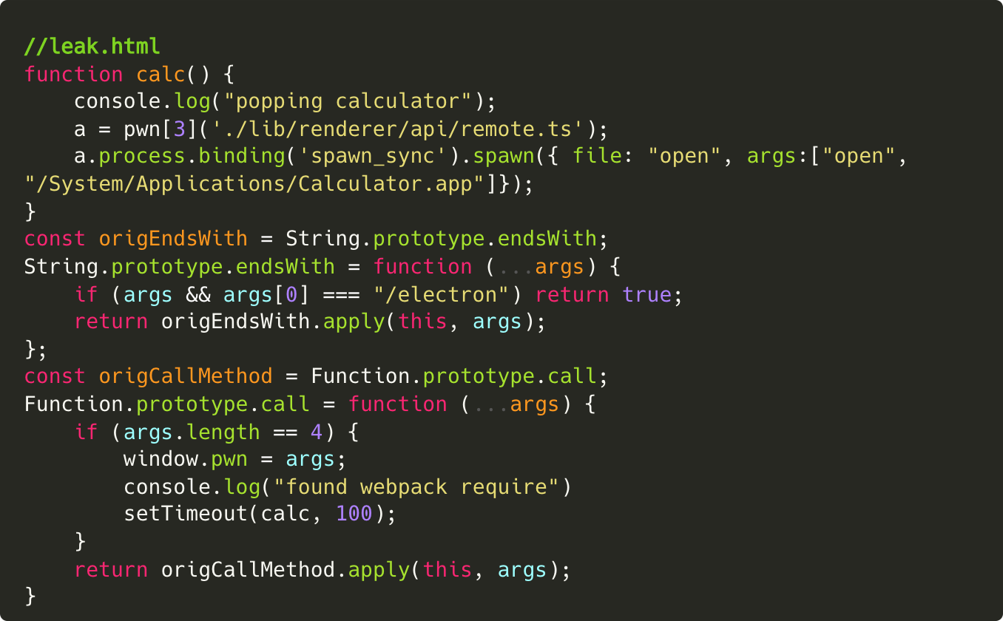
Disabling CISO on old electron version
1

Slide 63
Same Site Origin Spoofing

Slide 64
Same Site Origin Spoofing
Same site origin spoofing is also an important issue to take care on electron. Attacker can spoof origin to main window from an XSS on subdomain within embeds and can access node/contextBridge APIs.
app.example.com:443 (normal website loaded through main.js)
app.example.com:8080 (sandboxed website loaded in iframe where we have XSS)
Site-Isolation rules won’t apply here as it is still same-site (but not same-origin). Hence, chrome uses the same process for both the pages.
Renderer exploit in an embed can directly set security_context_.security_origin_.port to parent’s port & document_.url_ to parent’s URL.

Slide 65
Patch Gap
There is a noticeable patch gap between chrome <-> Electron <-> Electron Apps which makes most of them susceptible to these attacks.
Sandbox Escapes from Chromium can also be used.

Slide 66
Mitigations
Enable all the security flags
Don’t use embeds which don’t have good security track record (third party embed)
Mitigate security vulnerabilities (XSS, Open URL Redirection, etc.) on all your assets (even subdomains)
Upgrade Electron regularly to make sure patch gap is not large
Don’t implement sensitive IPC on main process
Ensure that all IPC message handlers appropriately validate senderFrame
Ensure Adequate Segregation is present if you’re rolling out your own library which combines browser and application-level code
Read: https://www.electronjs.org/docs/latest/tutorial/security

Slide 67
Epilogue
In total we were able to achieve RCE on 18 different Electron applications
Examples: JupyterLab, Mattermost, Rocket.Chat, Notion, Basecamp and the ones covered within this talk are few of them

Slide 68
Research Team
Mohan Sri Rama Krishna Pedhapati @S1r1u5_
William Bowling @vakzz
Max Garrett @TheGrandPew
Aaditya Purani @aaditya_purani

Slide 69

Want to understand in detail about our findings and secure your Electron apps?
https://electrovolt.io

